Slide 1
WALMART SALES Predictive Modeling
TS Project
By: Lani Lewis & Kenya Roy
December 8, 2024

Slide 2
W A L M A R T
EDA
W A L

Slide 3
EDA | Data Preprocessing
TS Dataset Creation
Merge Data
Scale Data
Remove NA >50%
Split Data
Aggregate Date (Trend)
Notes:
quick

Slide 4
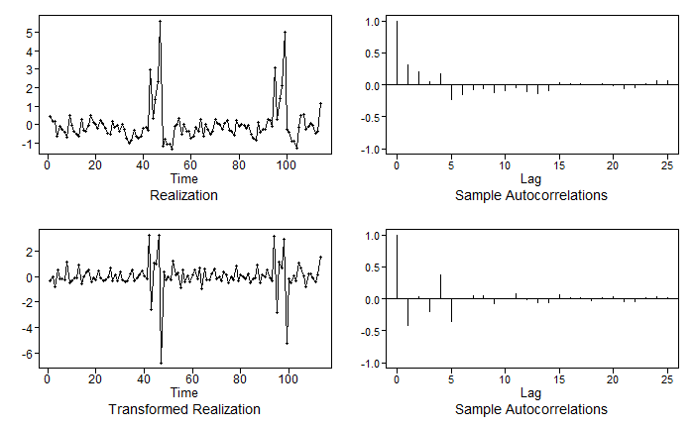
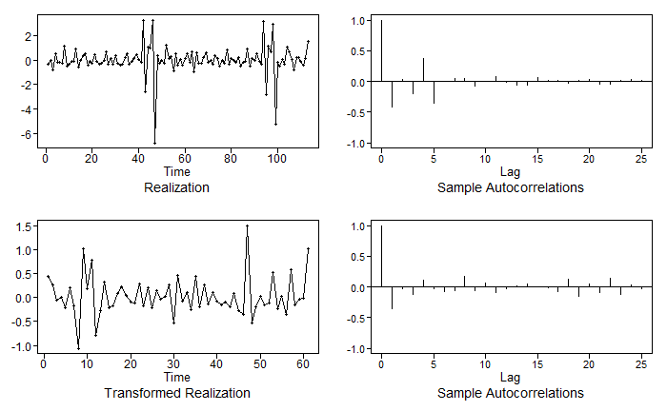
EDA | Scaling, Differencing
First difference (1-B) on scaled data
Seasonal (52)difference on first difference data
Notes:
Weekly sales of walmarts were in the millions -> scaled
Upon further exploration, we found that doing a first difference on the data was beneficial, we then applied a seasonal difference of 52
Applied log transformations to Fuel Price and Temperature (linearize the highly skewed data)

Slide 5

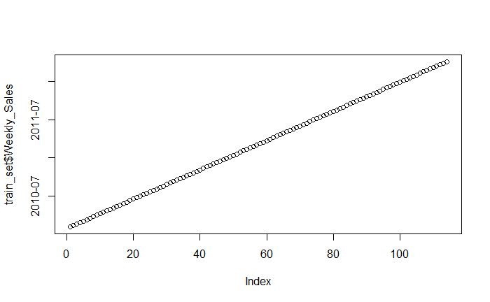
EDA | Understanding the Data
$ Weekly_Sales
Notes:
quick

Slide 6
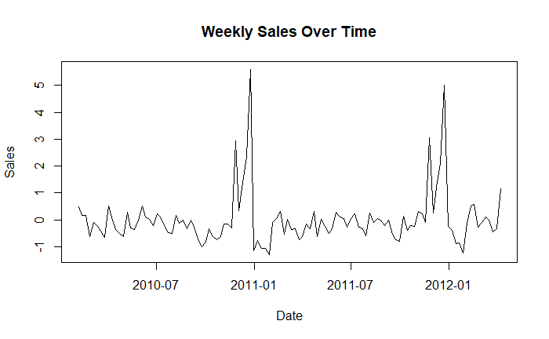
EDA | Understanding the Data
Holiday Peaks
November
December
Notes:
quick

Slide 7
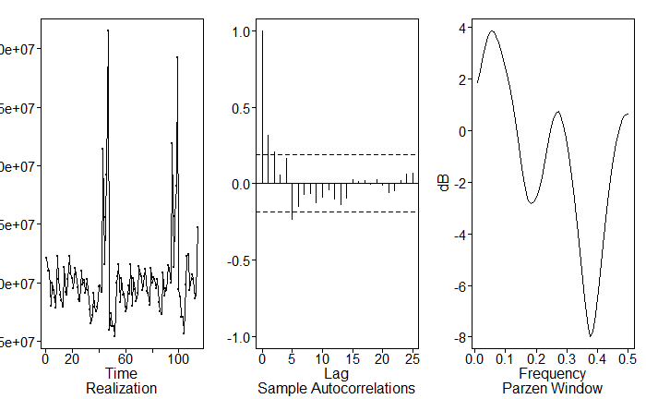
TSWGE PLOTS | Realization, ACF, Spectral Density
Notes:
- Realization: The sharp spikes and upward or downward trends suggest that the series is non-stationary (mean and variance are not constant over time).
- ACF: Strong correlations at lag 1 and lag 2, gradually decreasing, also indicating non-stationarity.
- Spectral Density: looks like we have three high peaks the first is the strongest and we see high peaks around period 12 (13/14)
- The next import periods are around 3 then 2...
- The overall behavior indicates that differencing might be required to stabilize the series. ---------------------------------------------------- How we found 1-B
Looking at the frequencies and spikes in the time series, we recognized a frequency of 52 and 12 in the TS
How we came up with 52 and 12 for spec dens

Slide 8
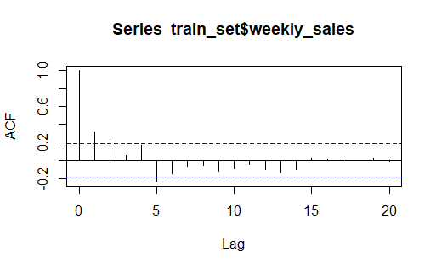
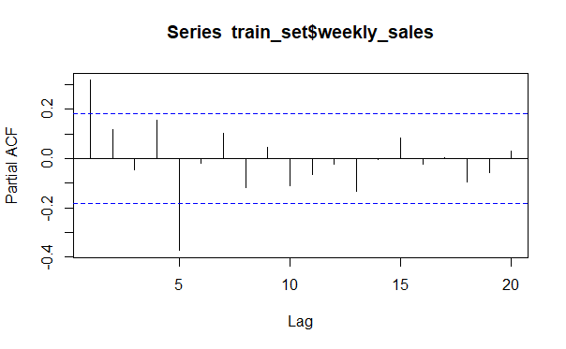
TSWGE PLOTS | ACF [MA(q)] and PACF [AR(p)]
Notes:
TBD
Acf - Maybe MA(4) don't coun the first lag
PACF - maybe a AR(4)
- scaled it looks like an AR(2)
You could the first lag

Slide 9
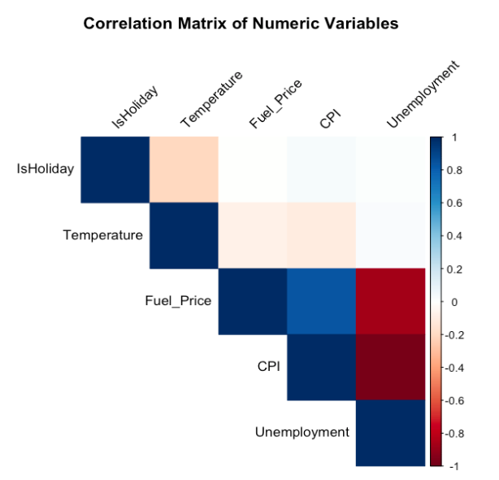
TSWGE PLOTS

Slide 10
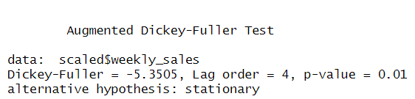
Dickey-Fuller Test for Stationarity
Notes:
- Reject the null hypothesis of Non-Stationarity
- This test was not as helpful as I had hopped cause we know that we need to difference the model from the plots above.
- This is actually a non-stationary model based off Kaggle as well. On the site they already mention this is a non-stationary model

Slide 11
W A L M A R T
PROJECT MODELS
At least 2: ARMA / ARIMA / ARUMA / Signal Plus Noise
At least 1: VAR
At least 1: Neural Network (MLP)
At least 1: Ensemble model
W A L

Slide 12
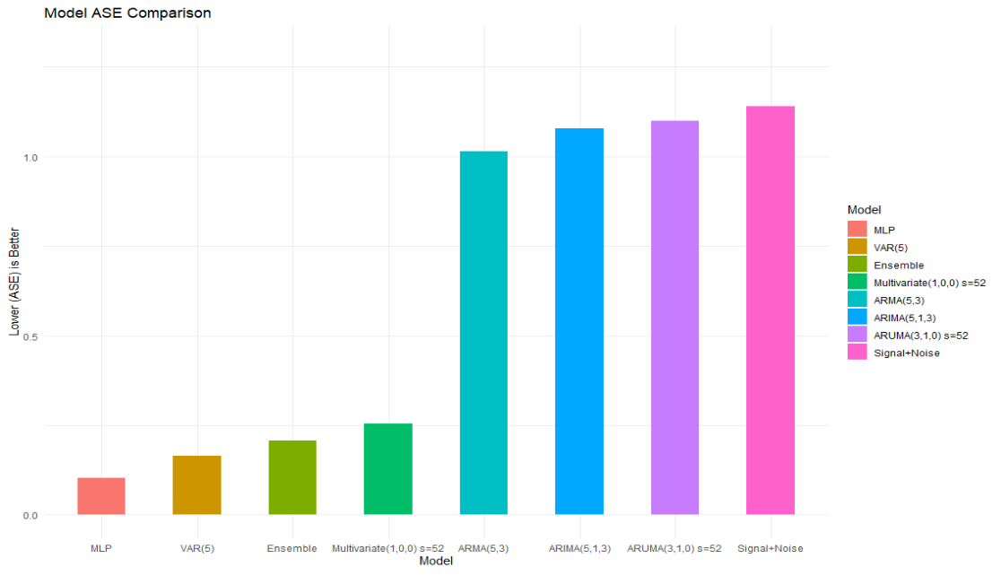
ASE MODEL REVIEW

Slide 13
W A L M A R T
ARMA(5,3) MODEL
W A L

Slide 14
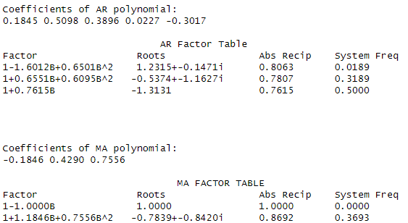
ARMA(5,3) MODEL | Factor Table
est.arma.wge

Slide 15
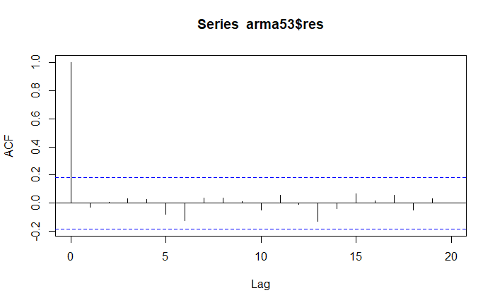
ARMA(5,3) MODEL | Residual White Noise

Slide 16
ARMA(5,3) MODEL | Ljung Box Check
p-value 0.8608568
PASS
p-value 0.9770763

Slide 17
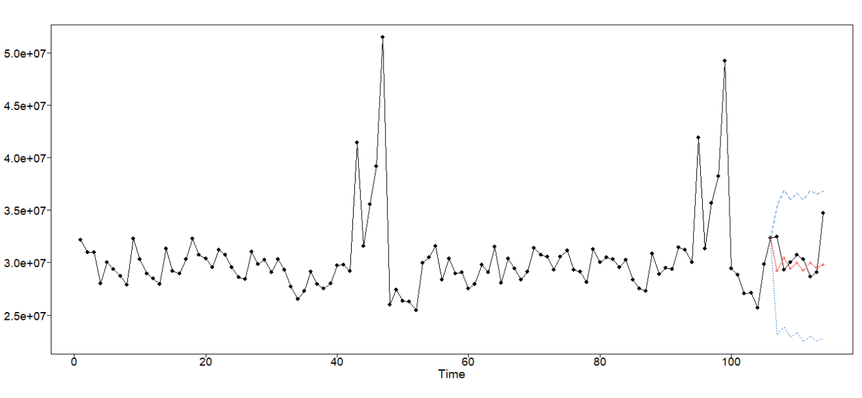
ARMA(5,3) MODEL FORECAST
ASE: 1.014748

Slide 18
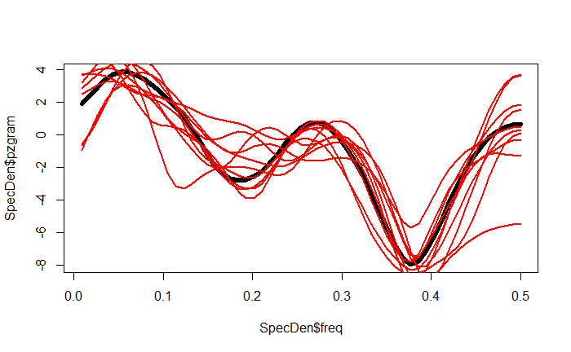
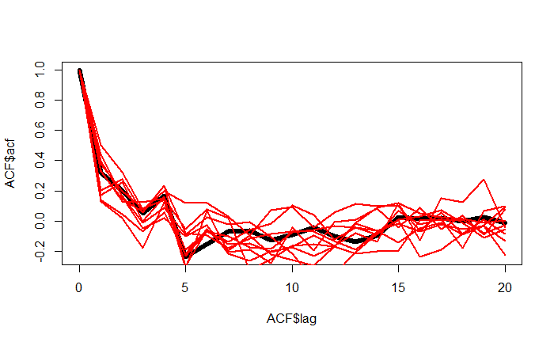
ARMA(5,3) MODEL COMPARISONS
10 Spectral Density Comparisons
10 ACF Comparisons

Slide 19
W A L M A R T
FINAL ARMA (5,3) MODEL
W A L

Slide 20
W A L M A R T
ARIMA(5,1,3) MODEL
W A L

Slide 21

ARIMA(5,1,3) MODEL | Difference 1-B

Slide 22
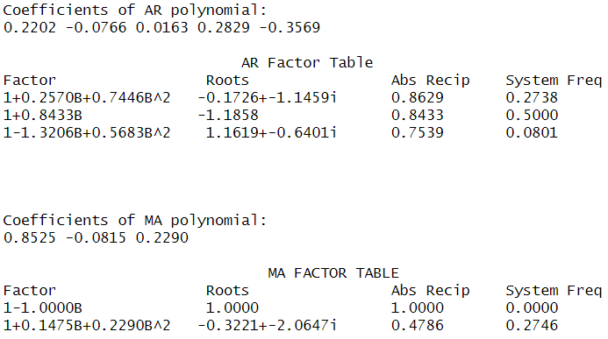
ARIMA(5,1,3) MODEL | Factor Table
est.arma.wge

Slide 23
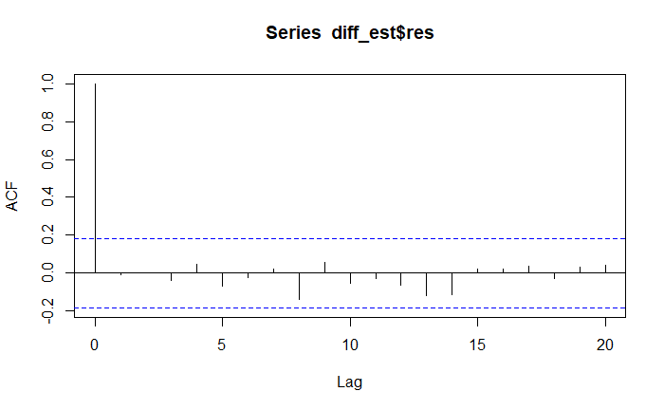
ARIMA(5,1,3) MODEL | Residual White Noise

Slide 24
ARIMA(5,1,3) MODEL | Ljung Box Check
p-value 0.7744939
PASS
p-value 0.9933498

Slide 25
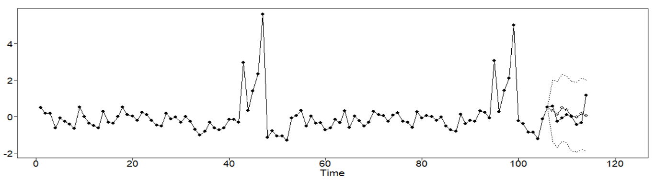
ARIMA(5,1,3) MODEL FORECAST
ASE: 1.077798

Slide 26
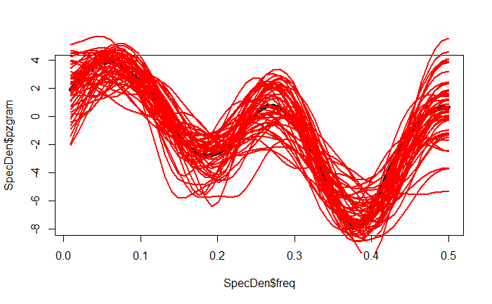
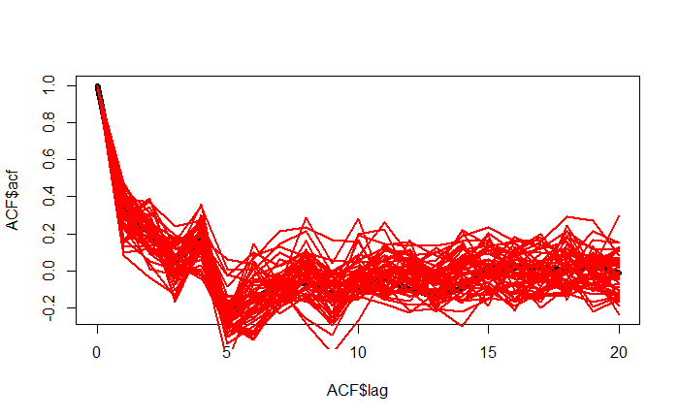
ARIMA(5,1,3) MODEL COMPARISONS
10 Spectral Density Comparisons
10 ACF Comparisons

Slide 27
W A L M A R T
FINAL ARIMA(5,1,3) MODEL
W A L

Slide 28
W A L M A R T
VAR MODEL
W A L
Notes:
Scaled$weekly_sales data is stationarized

Slide 29
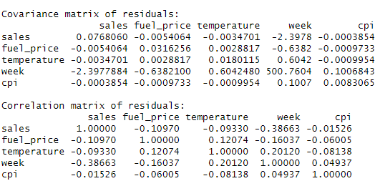
VARMODEL | Correlation and Covariance Matrices
VAR
Notes:
Varselect gave us a VAR(5) model using the scaled data. Covariance: Low residual variance for target variable shows that the model is good at predicting sales
Correlation: sales and week’s residual shows that the model didn’t fully capture the trend in the TS

Slide 30
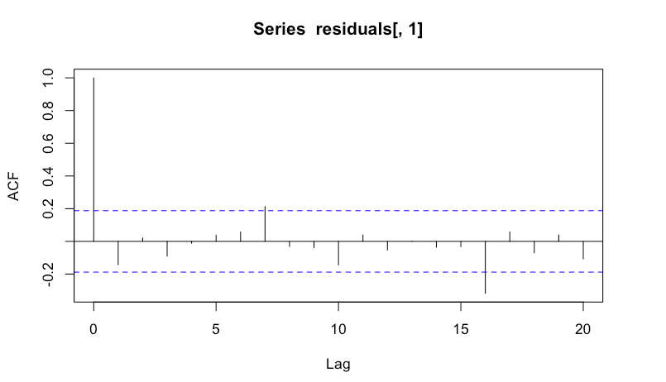
VAR MODEL | Residual White Noise

Slide 31
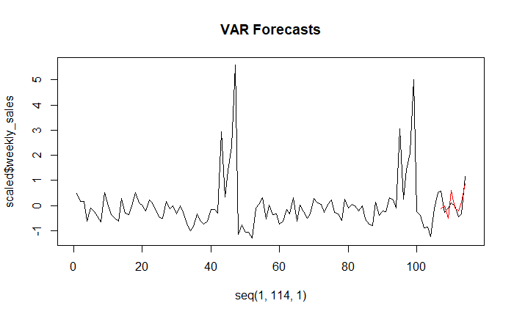
VAR(5) MODEL FORECAST
Average Lower CI: -0.4550076
Average Upper CI: 0.8153881
ASE: 0.16538
ASE: 1.757819e+12
Notes:
Fitting a model with seasonal dummy of 52, we calculated forecasts and found a pretty accurate model in VAR(5). We also found the upper and lower bounds of the confidence interval. Essentially, the VAR model

Slide 32
W A L M A R T
FINAL VAR(5) MODEL
W A L

Slide 33
W A L M A R T
MULTIVARIATE ARUMA(1,0,0) w/ s=52 MODEL
W A L

Slide 34
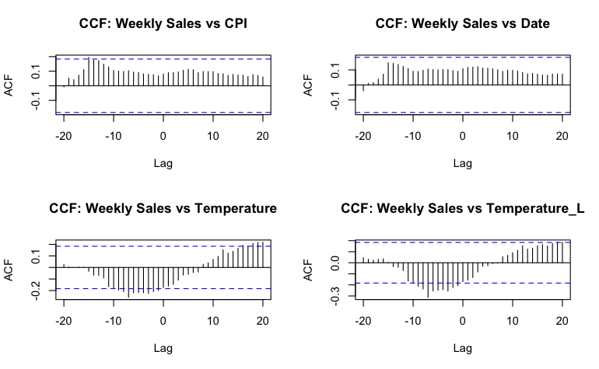
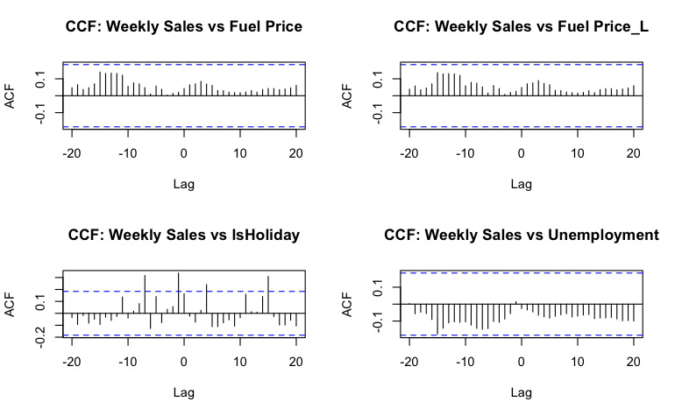
LAGGING VARIABLES
Notes:
We could have taken advantage of the different lags observed in these ACF plots but our content knowledge of the effect of Holidays on sales led us to decide to lag every variable by 1.

Slide 35
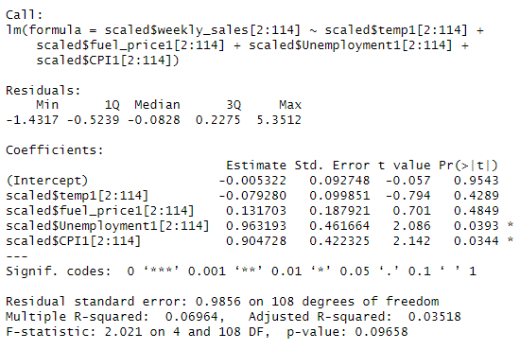
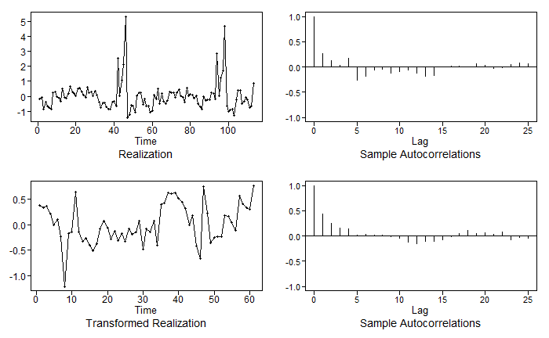
MULTIVARIATE MODEL | Difference Reg Residuals
Notes:
The range of residuals shows there’s unexplained relationships with the scaled data. We elected to do a seasonal difference of 52 on the data which improved the autocorrelations.

Slide 36
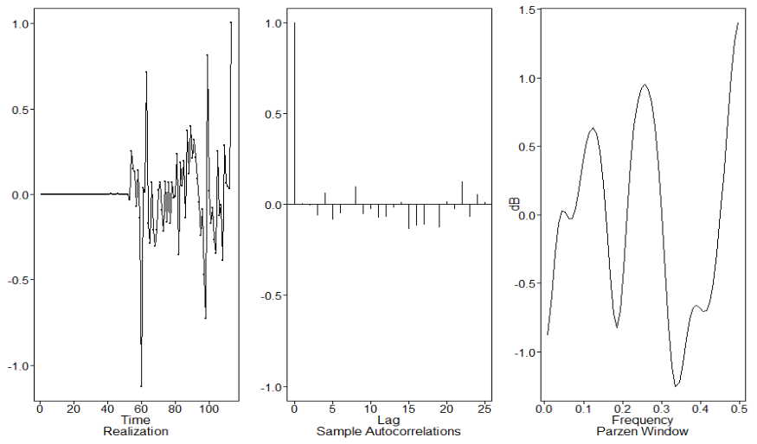
MULTIVARIATE MODEL |Fit ARUMA to resids
Notes:
AIC recommended an order of 1,1,0 and returned an improved autocorrelation plot.

Slide 37
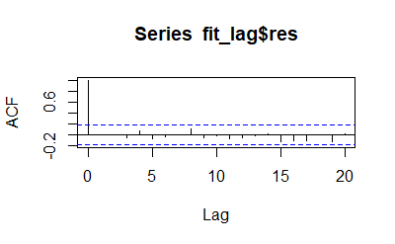
ARUMA(1,0,0) MODEL | Residual White Noise

Slide 38
ARUMA(1,0,0) MODEL | Ljung Box Check
p-value = 0.8664807
PASS
p-value = 0.7185762

Slide 39
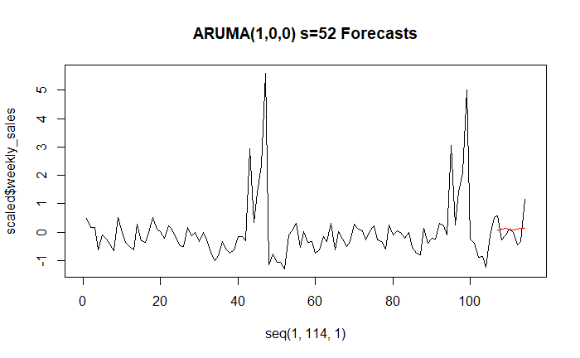
ARUMA(1,0,0) w/ S=52 MODEL FORECAST
ASE: 0.2549112
Notes:
Despite the low ASE, the forecasts don’t line up which can be seen with the comparison of ACF and spectral densities.

Slide 40
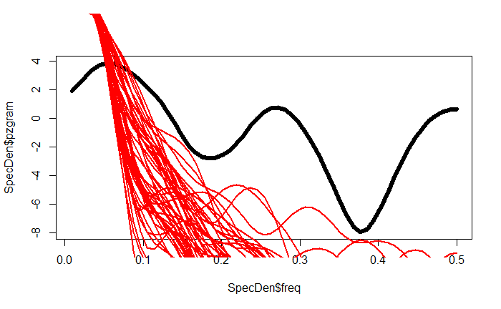
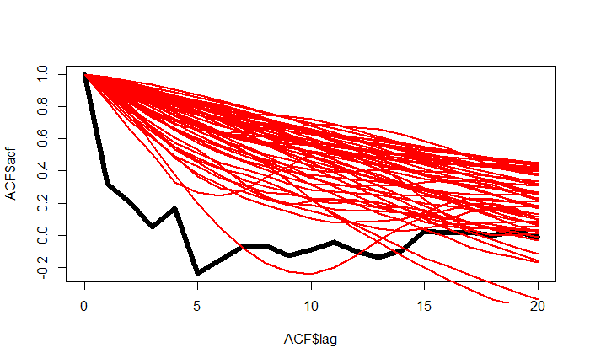
ARUMA(1,0,0) MODEL COMPARISONS
10 Spectral Density Comparisons
10 ACF Comparisons

Slide 41
W A L M A R T
FINAL MULTIVARIATE ARUMA(1,0,0) w/ s=52 MODEL
W A L

Slide 42
W A L M A R T
MLP MODEL
W A L

Slide 43
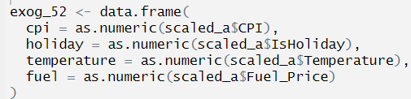
MLP MODEL | TS Configuration

Slide 44
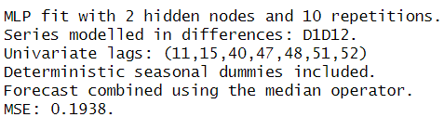
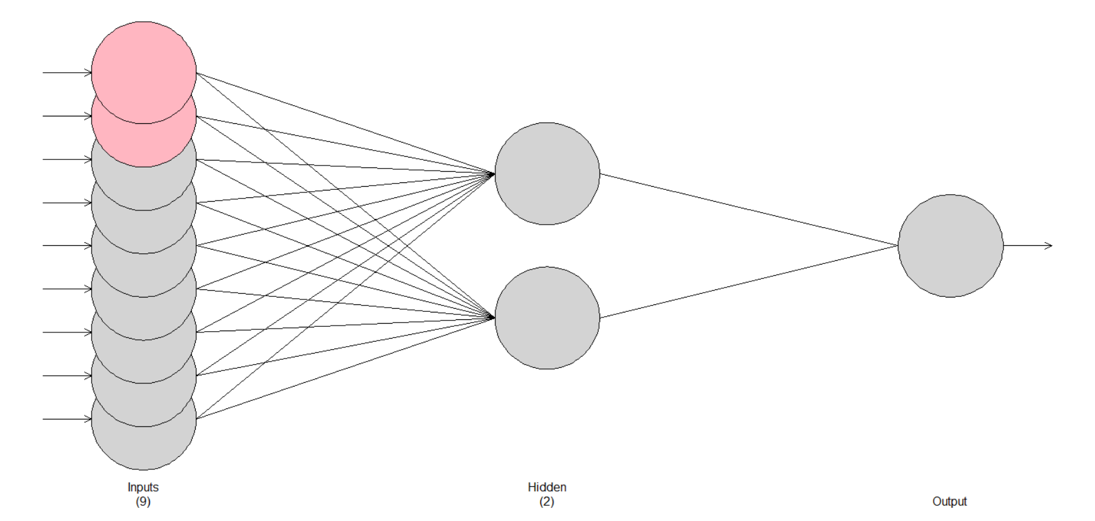
MLP MODEL
mlp52 = mlp(d52_train,reps = 10, comb = "median", difforder = c(1,12), allow.det.season = T, hd.auto.type = "cv", sel.lag = T, xreg = exog_52)

Slide 45
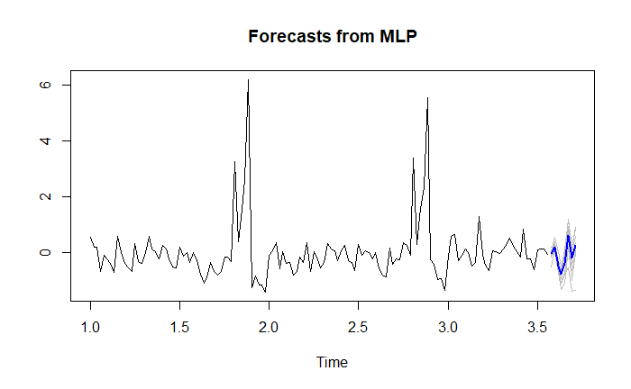
MLP MODEL FORECAST
ASE: 0.1026821

Slide 46
W A L M A R T
ENSEMBLE
W A L
Notes:
15 seconds

Slide 47
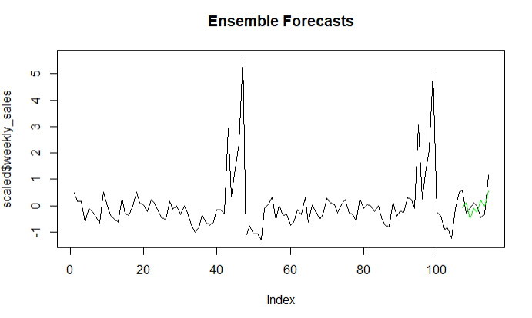
ENSEMBLE – MLP + VAR
ASE = 0.2080437
Notes:
Ensemble predictions were averages of the mean forecasts of MLP and VAR predictions.

Slide 48
W A L M A R T
Final Model Review
W A L
Notes:
1 minute tops

Slide 49
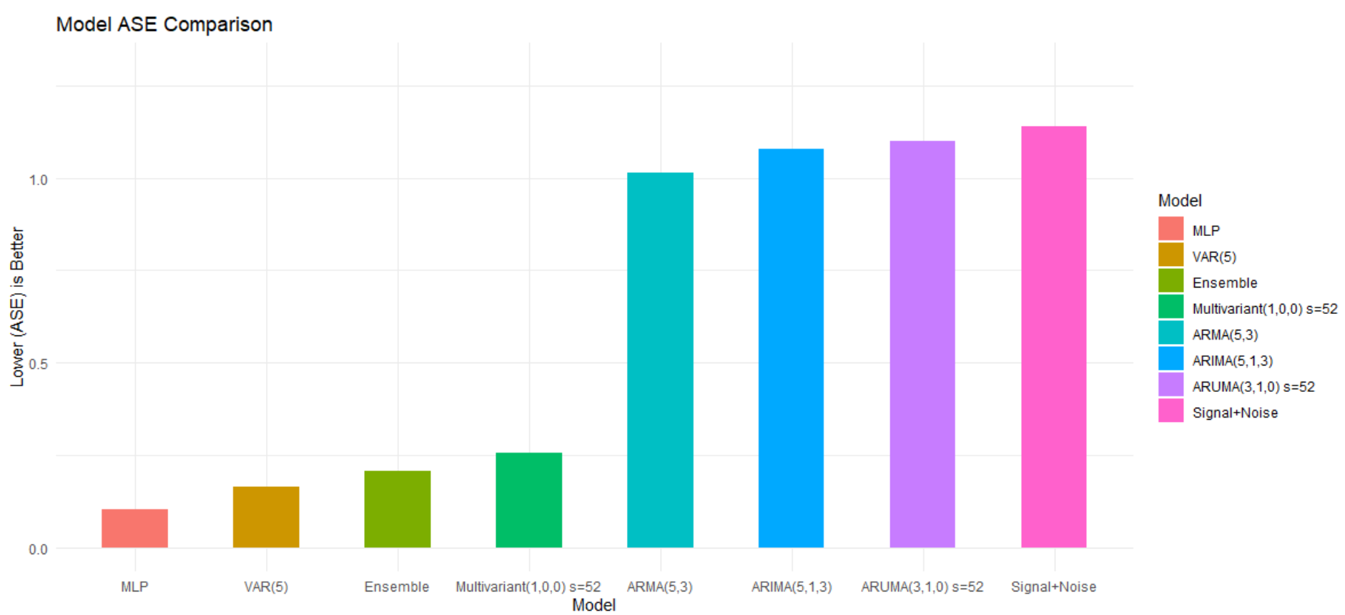
ASE MODEL REVIEW
Notes:
MLP 0.10268216
VAR(5) 0.16538168
Ensemble 0.20804375
Multivariate(1,0,0) s=52 0.25491121
ARMA(5,3)1.01474772
ARIMA(5,1,3)1.07779773
ARUMA(3,1,0) s=52 1.09979194
Signal+Noise1.1394492

Slide 50
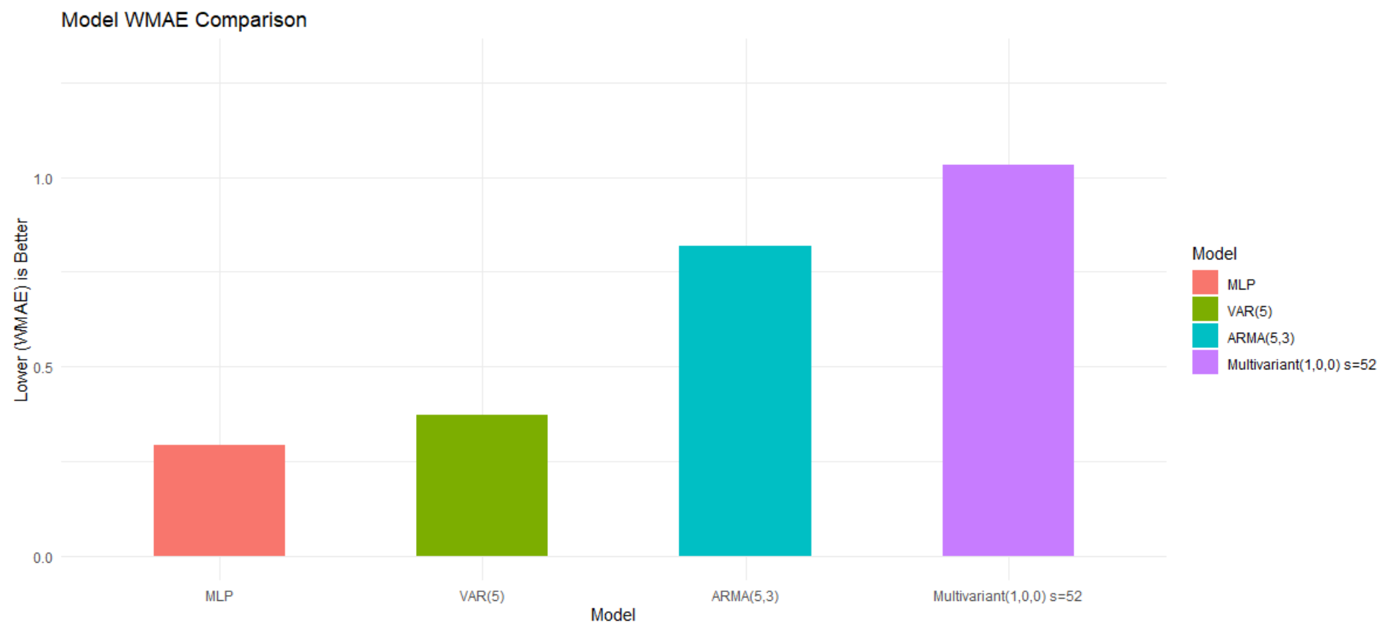
KAGGLE WMAE BEST MODELS REVIEW

Slide 51
W A L M A R T
Thank-You
For additional inquiries, please contact Lani Lewis (lanil@mail.smu.edu) and Kenya Roy (kroy@mail.smu.edu)
W A L

